Slide 1

Automotive Technology: A Systems Approach, 8e
Chapter 45: Tires and Wheels
Rob Thompson and Jack Erjavec, Automotive Technology: A Systems Approach, 8th Edition. © 2025 Cengage. All Rights Reserved. May not be scanned, copied or duplicated, or posted to a publicly accessible website, in whole or in part.

Slide 2
Chapter Objectives (1 of 2)
45.01 Describe basic wheel and hub design.
45.02 Explain the tire ratings and designations in use today.
45.03 Describe the operation, diagnosis, and service for a tire pressure monitor.
45.04 Inspect the wheel and tire assembly for runout.

Slide 3
Chapter Objectives (2 of 2)
45.05 Remove, replace, and install a wheel and tire assembly.
45.06 Perform wheel and tire services and repairs.
45.07 Describe and service various types of wheel bearings.

Slide 4
Wheels
45.01 Describe basic wheel and hub design.
Can be steel, aluminum, or magnesium.
Aluminum and alloy wheels are used to reduce weight.
The wheel is bolted to a hub.
Replacement wheels must be equal to OE.
Incorrect wheels can affect bearing life, speedometer readings, and ABS function.

Slide 5
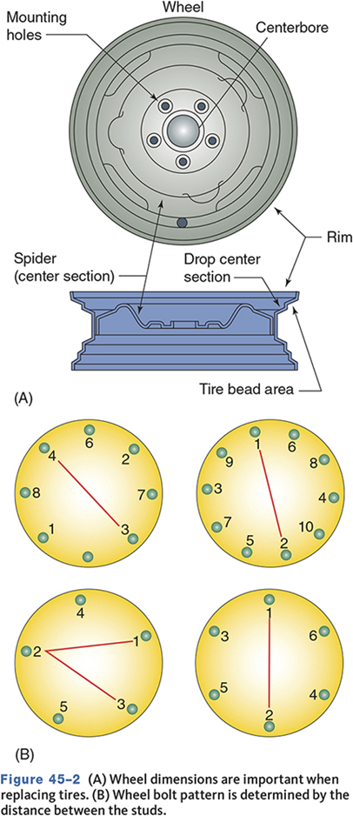
Wheel Dimensions
Diameter
Width
Offset

Slide 6
Tires
Provide traction and absorb road shock.
Also carry the weight of the vehicle, withstand side thrust, and transfer braking and driving torque.
Traction and friction must be balanced to reduce rolling resistance.

Slide 7
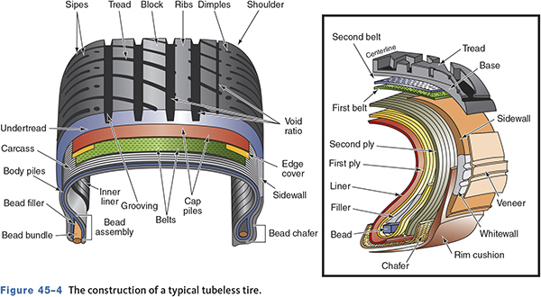
Tubeless Tires

Slide 8
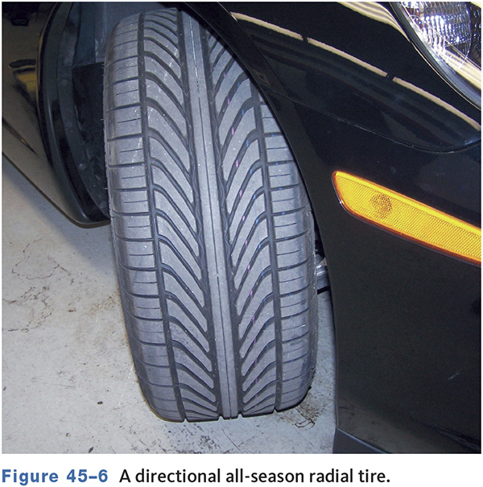
Specialty Tires
Designed for specific road conditions or applications
  All season tires
  Snow tires
  Studded snow tires
  Slicks
  Wet surface designs

Slide 9
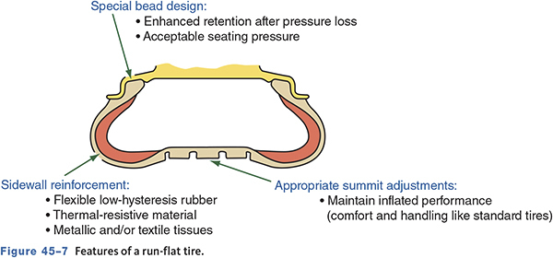
Run-Flat Tires

Slide 10
Tread Designs
Directional
  Must revolve in one direction.
Nondirectional
  Can revolve either direction.
Symmetric
  Tread pattern is the same across the tire.
Asymmetric
  Tread is different from inside to outside.

Slide 11
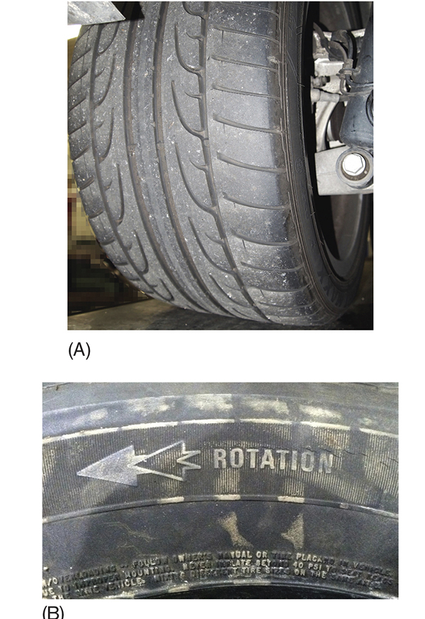
Directional Tire
Made to rotate in one direction.
Must be mounted on wheel correctly and installed on the correct side of the vehicle.

Slide 12
Knowledge Check (1 of 3)
Technician A says a symmetric tire has a tread design that is different from one side of the tire to the other.
Technician B says a symmetric tire has the same tread pattern on both sides of the tire.
Who is correct?

Slide 13
Knowledge Check Answer (1 of 3)
Technician A says a symmetric tire has a tread design that is different from one side of the tire to the other.
Technician B says a symmetric tire has the same tread pattern on both sides of the tire.
Who is correct?
Answer: Technician B only

Slide 14
Spare Tires
Can be a full size replacement tire.
Many vehicles have compact spare tires.
  High-pressure mini spare
  Space-saver spare
  Lightweight skin spare
Some vehicles without run-flat tires have no spare.

Slide 15
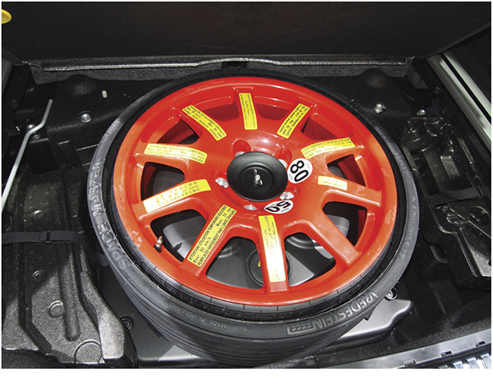
Temporary Spare Tire

Slide 16
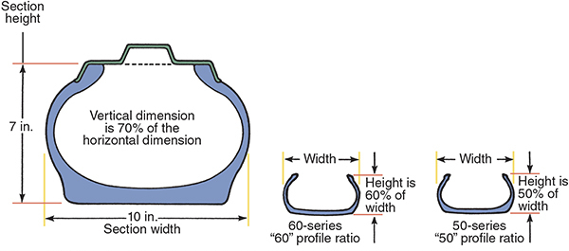
Tire Ratings and Designations
45.02 Explain the tire ratings and designations in use today.

Slide 17
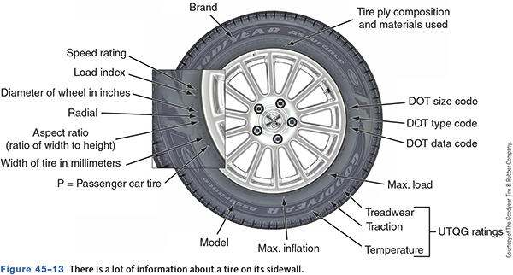
Tire Sidewall Information

Slide 18
Other Information (1 of 2)
DOT information
  Tire serial number.
UTQG rating
  Uniform Tire Quality Grade.
Tread Wear
  200 should last longer than 100.

Slide 19
Other Information (2 of 2)
Traction
  Based on wet stopping distances.
Temperature resistance
  Heat dissipation.
Inflation information
  Maximum cold inflation pressures and loading.

Slide 20
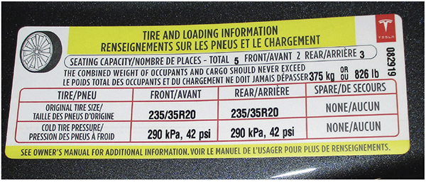
Tire Placard
Can be found on door jamb, glove box, fuel door, or console lid.

Slide 21
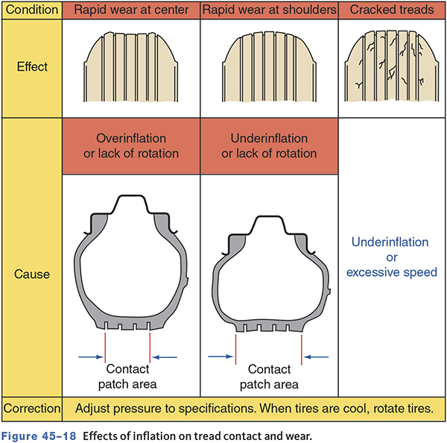
Inflation Pressure

Slide 22
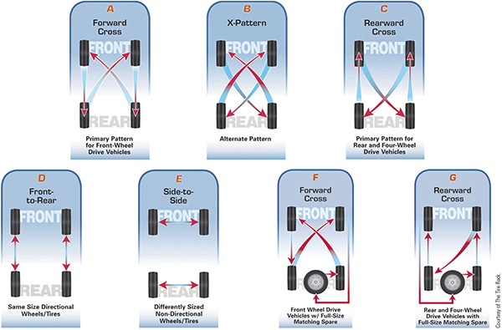
Tire Rotation

Slide 23
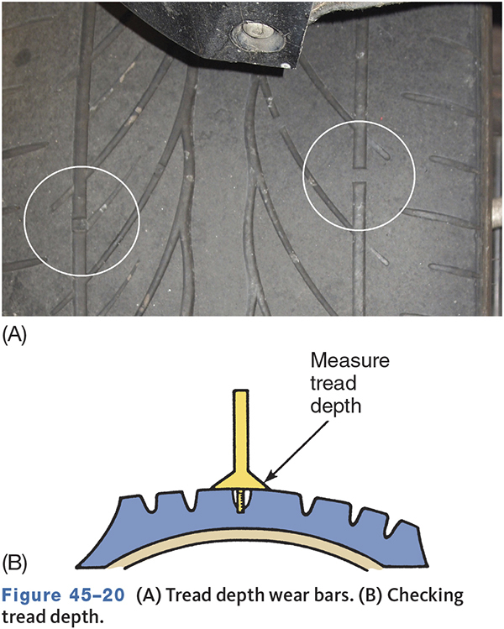
Tread Depth

Slide 24
Tire Pressure Monitor (TPM)
45.03 Describe the operation, diagnosis, and service for a tire pressure monitor.
Standard on all 2007 and newer passenger vehicles 10,000 pounds or less.
Must illuminate a warning light if pressure is 25 percent below recommended cold pressure.
Two systems used
  Direct
  Indirect

Slide 25
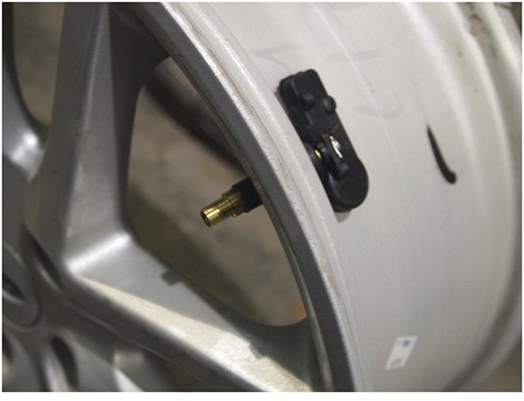
Direct TPMS
Use pressure sensors in each wheel to transmit pressure.
Sensors may be part of valve stem or strapped to wheel drop center.

Slide 26
Indirect TPMS
Meets standard at lower cost.
Use input from ABS wheel speed sensors.
A tire with low pressure will have a different number of revolutions per mile.
Indirect systems not as accurate.
Do not tell driver which tire is low.

Slide 27
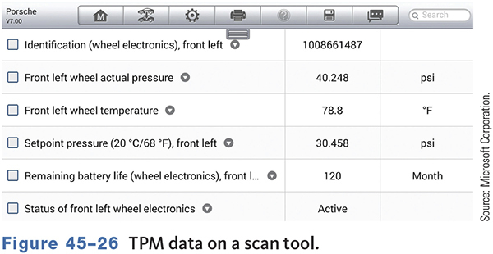
TPMS Scan Tool Data

Slide 28
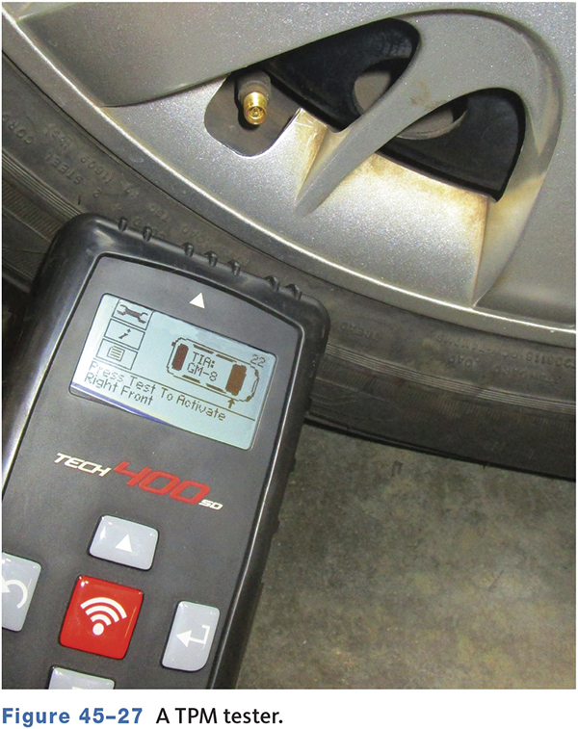
TPMS Test Tool
A TPM sensor tool is a wireless tool that may be used with a scan tool for diagnosing sensors and allowing the system to relearn when a part has been replaced.

Slide 29
Knowledge Check (2 of 3)
Technician A says vehicles with TPM systems may require special tire service procedures.
Technician B says the TPM system may need to relearn sensor location after a tire rotation.
Who is correct?

Slide 30
Knowledge Check Answer (2 of 3)
Technician A says vehicles with TPM systems may require special tire service procedures.
Technician B says the TPM system may need to relearn sensor location after a tire rotation.
Who is correct?
Answer: Both Technicians A and B

Slide 31
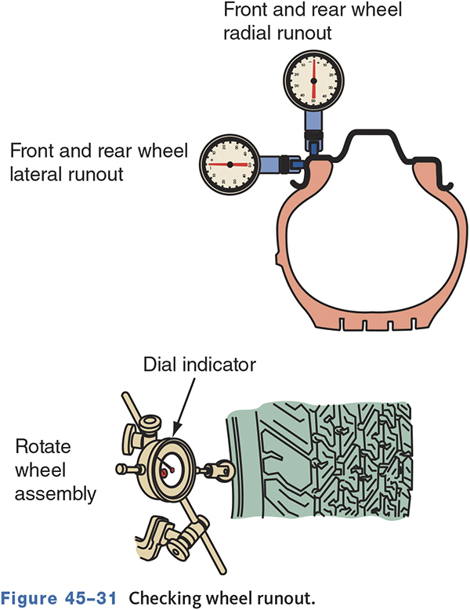
Tire/Wheel Runout
45.04 Inspect the wheel and tire assembly for runout.
An out-of-round tire/wheel has radial runout.
A tire/wheel that wobbles side-to-side has lateral runout.

Slide 32
Tire Pull
A tire can cause a pull while driving.
Developed during tire manufacturing.
Rotate tires to reduce or eliminate the pull.
May require tire replacement.

Slide 33
Tire Replacement
45.05 Remove, replace, and install a wheel and tire assembly.
Choose a tire that matches the original tires.
Conditions that require replacement
  Blisters or bulges.
  Ply separation.
  Broken or cracked beads.
  Fabric cracks or cuts.
  Wear indicators showing.
  Punctures larger than 1/4 inch (6 mm).

Slide 34
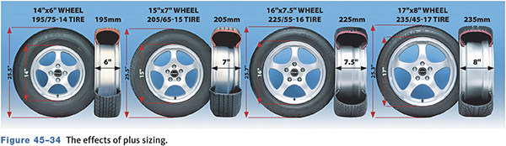
Changing Tire and/or Wheel Size

Slide 35
Calculating Tire Dimensions
To determine section height
Width x aspect ratio = section height
To determine overall diameter.
Combined section height (sectional height x 2)
+ wheel diameter = tire diameter

Slide 36
Tire Repair
45.06 Perform wheel and tire services and repairs.
Most punctures can be repaired.
Sealants may seal but may not
  Never use sealants on sidewall punctures.
Inflate to proper pressure and spray with soapy water.
If the tire has a TPMS sensor, unbolt the sensor and allow it drop into the tire before attempting to dismount the tire.

Slide 37
Repair Methods
Head-Type Plug
  A plug is inserted into the puncture from the inside.
Cold Patch Repair
  A patch is glued to the inside of the tire.
Hot Patch Repair
  Similar to a cold patch, but heat is used to make it adhere to the tire.

Slide 38
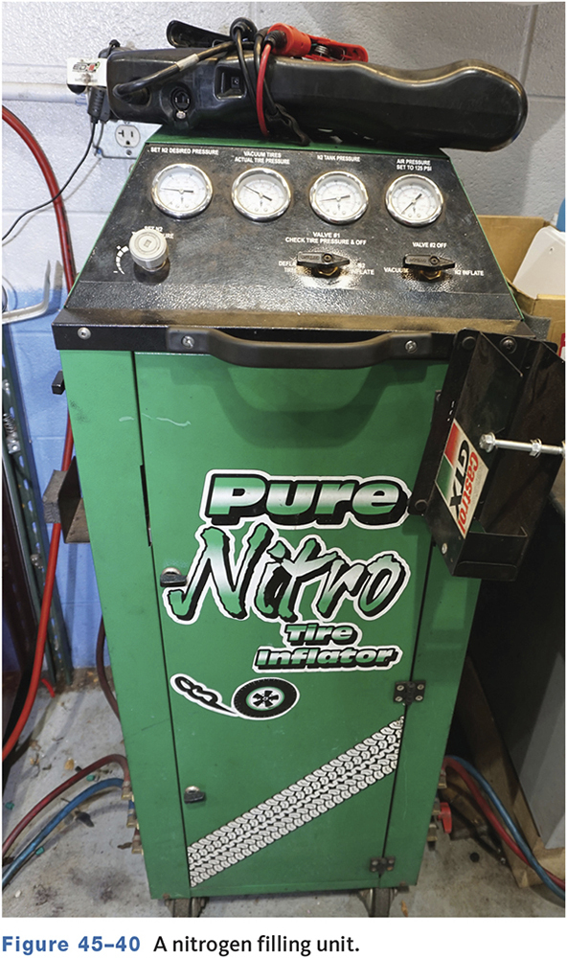
Inflation
Inflate to recommend pressure and check for leaks around beads and point of repair.
Some vehicles have tires inflated with nitrogen.
  More consistent pressure.
  Look for green valve stem caps.

Slide 39
Tire Installation
Carefully inspect the wheel, hub, lug nuts and studs.
Check wheel bearings.
Clean hub flange and wheel bore.
Coat flange with disc brake grease or similar.
Install, center, and seat wheel.
Torque to specifications.

Slide 40
Tire/Wheel Balance
Static Balance
  Is the equal distribution of weight around the wheel.
  Static unbalance causes wheel tramp.
Dynamic Balance
  Is the equal distribution of weight on either side of the centerline.
  Dynamic unbalance causes wheel shimmy.

Slide 41
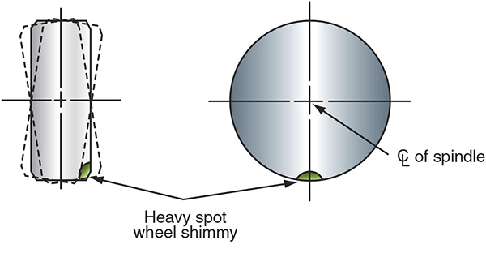
Dynamic Balance

Slide 42
Knowledge Check (3 of 3)
Technician A says static unbalance can cause Shimmy. Technician B says dynamic unbalance can cause wheel tramp.
Who is correct?

Slide 43
Knowledge Check Answer (3 of 3)
Technician A says static unbalance can cause Shimmy. Technician B says dynamic unbalance can cause wheel tramp.
Who is correct?
Answer: Neither Technicians A and B

Slide 44
Wheel Bearings
45.07 Describe and service various types of wheel bearings.
Typically, on driving axles, the wheel is mounted on the hub of an axle shaft and the shaft rotates on an axle bearing.
On non-driving wheels, the wheel hub rotates on bearings on a spindle shaft.

Slide 45
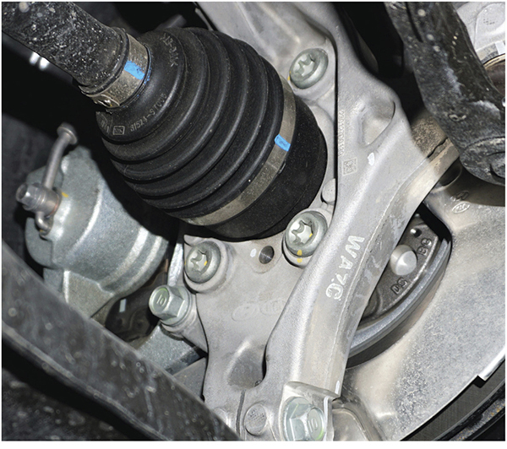
Front Wheel Hubs
Most are sealed and lubricated for life.
Replaced as an assembly.

Slide 46
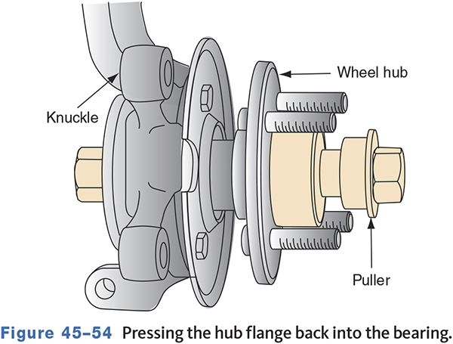
FWD and 4WD Vehicles
Typically not serviceable.
Pressed in and out of the hub.

Slide 47
Chapter Reflection
Describe a concept from this chapter that challenged you the most.
Describe what made the concept difficult for you and the steps you took to improve your understanding.
How could you help another learner who was struggling with the same concept.
Use 100–150 words in your answer.

